Slide 1
Project Overview

Slide 2
Introduction
UPSCALE
Upscaling Product development Simulation Capabilities exploiting Artificial intelligence for Electrified vehicles
UPSCALE is the first EU-project that has the specific goal to integrate artificial intelligence (AI) methods directly into traditional physics-based Computer Aided Engineering (CAE)-software and methods.
The objective of the project is to apply AI-methods to reduce the development time (20%) and increase the performance of electric vehicles (EVs). Focused on vehicle aero/thermal- and crash modelling.
UPSCALE aims to reduce simulation times by orders of magnitude while maintaining or improving accuracy significantly

Slide 3
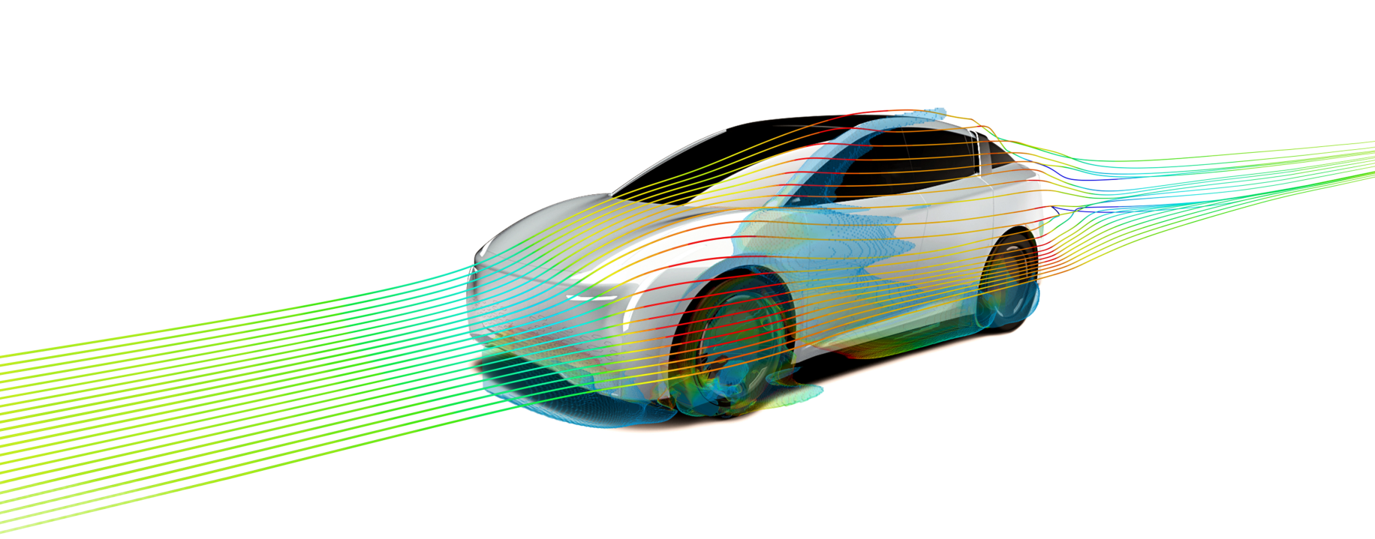
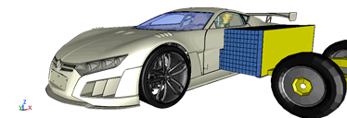
Project Scope
CFD:
Aerodynamics: forces and flow field prediction by means of segregated models (geometry parametrization)
Machine learning CFD enhanced solvers
pressure corrector solver
Physics informed turbulence modelling
Thermal battery modelling: Reduced Order Models
Crash:
Contact algorithm acceleration
Battery Reduced Order Models
Other complementary tools: Optimization algorithms, data management, partitioning

Slide 4
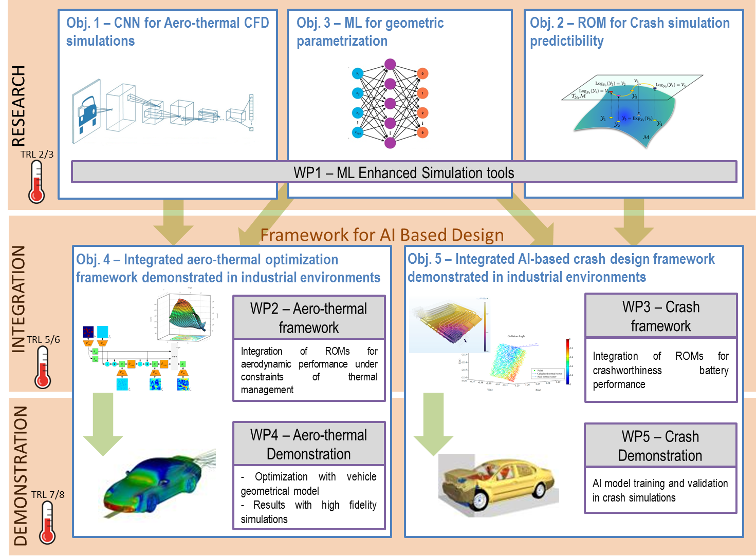
Project Structure

Slide 5

Facts
Project coordinator
Enric Aramburu, Applus+ IDIADA
11 partners from 8 European countries
General timing
November 2018 – April 2022
Allocated total budget (100% funded)
4M €
www.upscaleproject.eu

Slide 6












